Slide 1
PrEP Navigation: challenges and opportunities with PrEP access
Juan Carlos Loubriel (he-him-El)
Sr. Director of Community Health and Wellness
Whitman-Walker Health

Slide 2
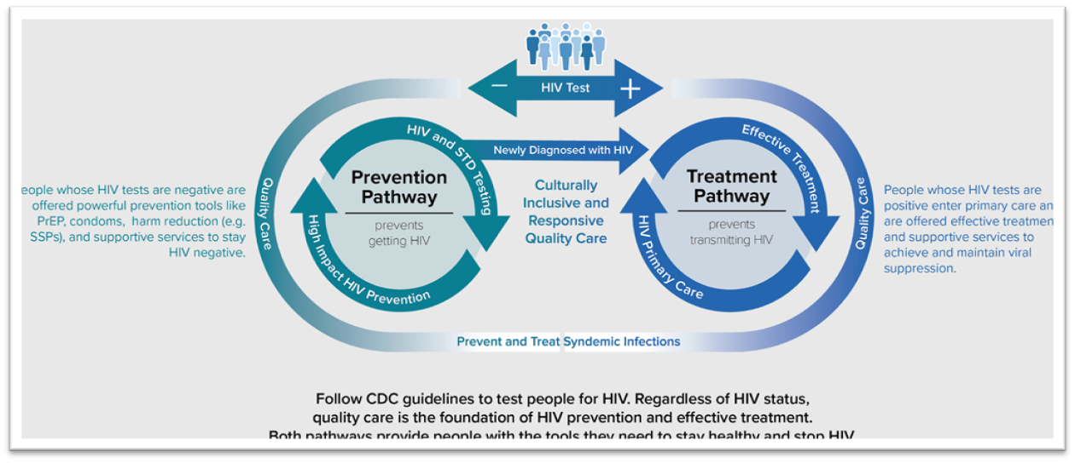
Integrated Care: Status Neutral Approach
Scaling up PrEP and optimizing retention will require engaging community health workers or non-traditional trained health staff to work along the PrEP continuum of care.
Novel strategies are needed to reduce PrEP care disparities.
Centers for Disease Control and Prevention. (2022, October 14). Issue brief: Status neutral HIV care and service delivery eliminating stigma and reducing health disparities. Centers for Disease Control and Prevention. Retrieved November 2, 2022, from https://www.cdc.gov/hiv/policies/data/status-neutral-issue-brief.html#:~:text=Many%20HIV%20prevention%20experts%20believe,ahead%20of%20their%20HIV%20status.

Slide 3
PrEP Navigation: Challenges
Structural Barriers
Transportation
Inadequate screening
Insurance Coverage – Uninsured or underinsured
Longer wait times
Stigma and discrimination
Language barriers
Mistrust of healthcare system
Centers for Disease Control and Prevention. (2024, May 15). https://www.cdc.gov/public-health-gateway/php/about/social-determinants-of-health.html
Notes:
Advancing Access sometimes detects insurance coverage. To prevent this, PrEP Navigators have been reaching out to schedule PrEP starts to complete the PAP application ahead of time to anticipate any barriers before the appointment.
Advancing Access sometimes detects insurance coverage. To prevent this, PrEP Navigators have been reaching out to schedule PrEP starts to complete the PAP application ahead of time to anticipate any barriers before the appointment.

Slide 4
Best Practices: Anticipating Access and Adherence-related barriers
Insurance-related barriers are a common reason individuals vulnerable to HIV do not start PrEP or fall out of PrEP care
Continuing to monitor insurance and coverage changes is key. LAI CAB is still a new therapy, and coverage by payors is not always guaranteed
Dedicated pharmacy staff manage insurance eligibility and access to medication
Retention – we conduct real time tracking of appointment windows and utilize software platforms to decrease missed appointments
PrEP Navigators assess medication coverage for uninsured clients and provide application support through Patient Assistance Programs as needed
PEP to PrEP
PrEP Navigators assist with transition from PEP to PrEP education and adherence
Notes:
Getting ahead of the barriers is away to anticipate any issues that might happen when applying for PAP so we help them apply when either when we scheduled their MHI PrEP start appointment or one day before they come into their appointment.
Another way is by empowering our patients to advocate for themselves example if they are on Apretude we encourage them to inform of insurance changes if they are aware or potential insurance changes. We explain to them that this will help us either figure out if they can continue Apretude with new coverage or if they have to go back on oral prep and prevent adherence to medication. This is true for patient taking oral PrEP as well because some insurance don't cover Truvada or Descovy unless a Prior Authorization or have the providers also send a letter of necessity. To prevent as much as possible any barriers.
PrEP Navigators provide personalized patient care support in a similar style of non-medical case management, striving for a status neutral approach

Slide 5
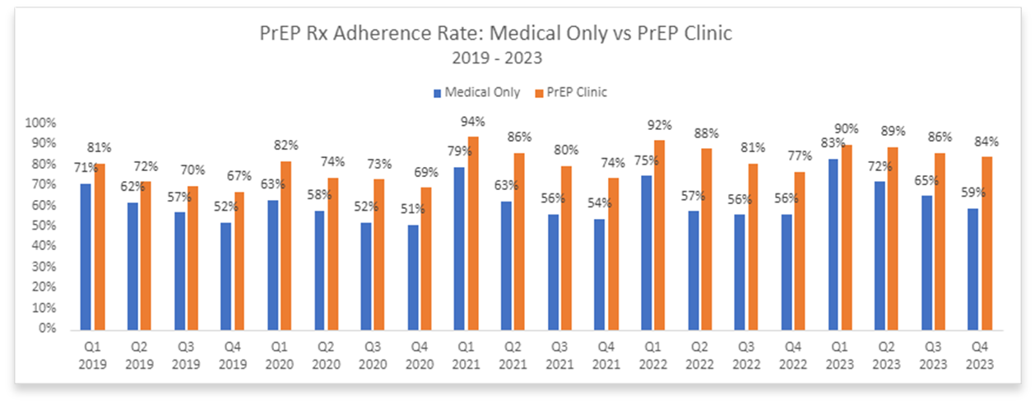
Peer PrEP Specialist Clinic: Higher Oral PrEP Care Retention vs. Medical Clinic (IAPAC 2023)
PrEP Clinic combines follow-up medical and pharmacy visits in one simple stop. Each appointment is approximately 20 minutes long and includes all necessary lab work and dispensing of medication.
Creation of detailed workflow PrEP care protocols implemented by PrEP Specialists under the guidance of a PrEP user’s primary care provider allowed for greater flexibility to potentially identify and resolve barriers to PrEP care for communities vulnerable to HIV.
The PrEP clinic increases provider capacity for appointments, evening hours, and ensures care that is quick, convenient, and PrEP user-centered.
PrEP Clinic: Peer PrEP Specialist-led
Services: Medication, Lab Draw, Counseling, Scheduling, Follow Up Visits, Reminders, Referral for Acute/Primary/Mental Health Care

Slide 6
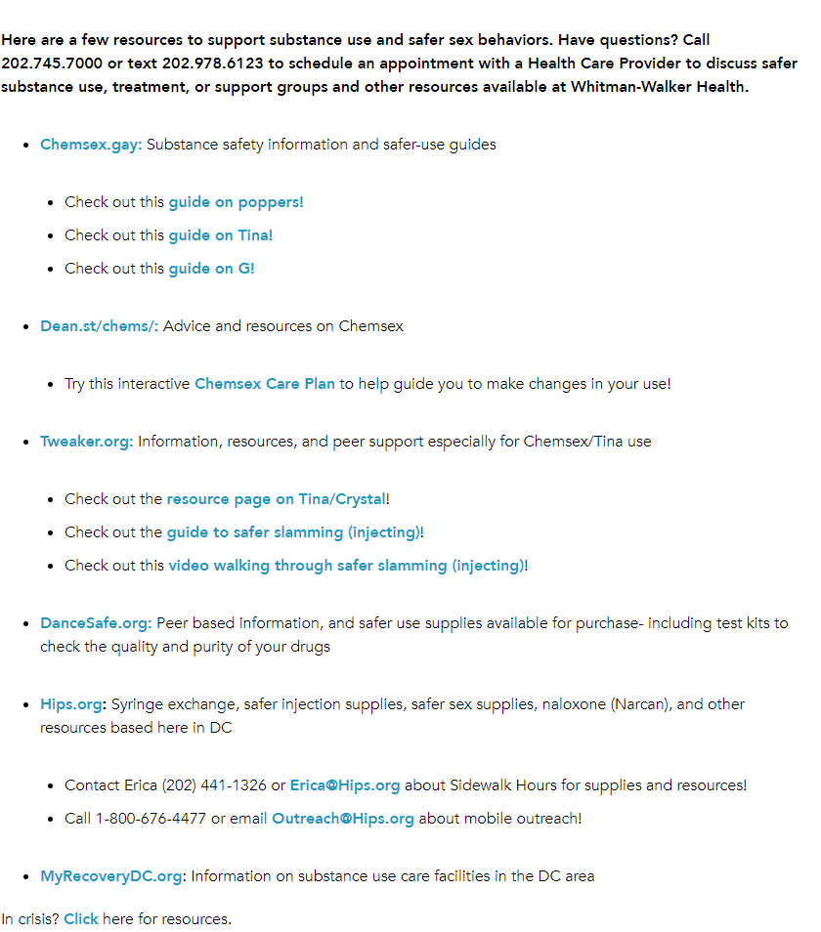
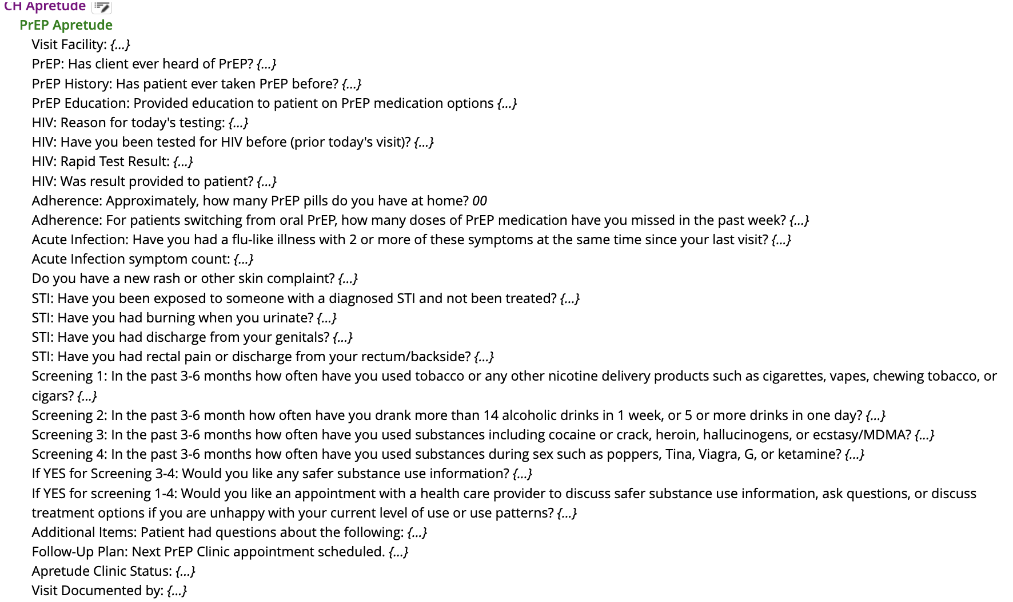
Best practices for screening and linkages
Creation of detailed risk assessment questionnaire
Screening for acute symptoms
Screening for substance use
Screening for adherence
Follow up plan
Referral to support services

Slide 7
Adherence Monitoring
Appointment scheduling system
Missed appointment rescheduling within 1-7 days and follow up plan with Artera® texting and calls
Real-time dashboard to identify inventory, missed appointments, and other information
Quarterly re-engagement campaign
Client satisfaction survey

Slide 8
Conclusion and Program Recommendations
Peer CHWs can aid PrEP retention/adherence among vulnerable communities to prevent new HIV infections
Programs that incorporate community health workers or non-traditional trained health staff into the model of PrEP care can help scale up PrEP and curb HIV transmission.
Getting Prepped: RECEIVING long-acting PrEP at Whitman Walker in Washington, D.C. (photo by Jimell Greene)

