Slide 1
Long-Acting Injectable PrEP Program Initiation and Administration by Community Health Workers
Juan Carlos Loubriel (He/Him/Él )
Senior Director of Community Health & Wellness
Kevin Jordan Contreras (He/Him/They)
Prevention Programs Manager
Michael Golden (He/They)
PrEP Clinic Coordinator
Parrish Brown (He/Him/His)
PrEP Clinic Coordinator

Slide 2
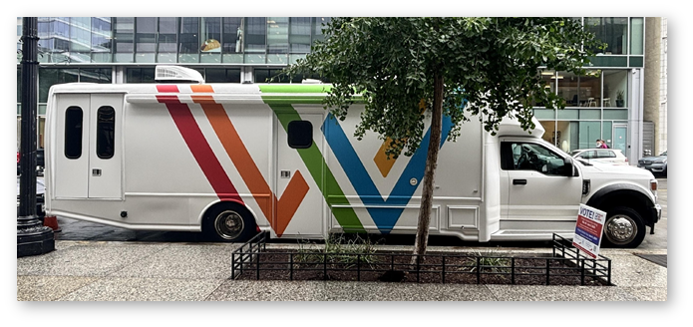
Whitman-Walker’s Programs & Services
Primary Medical Care
Infectious Disease Specialty Care
Dental Care
Behavioral Health
Substance Misuse Treatment
HIV/STI Testing & Prevention Services, including a PrEP Clinic
Gender Expansive Care Navigation
Policy & Advocacy
Medical Training & Education
Research
Legal Services
Mobile Health
Public Benefits & Insurance
Navigation
Youth Programs & Wellness Services
Special Community Events & Cultural Programs
Pharmacy Services
Peer Support Services
COVID-19 Testing, Vaccination & Outreach
MPV Testing, Vaccination & Outreach
Whitman-Walker at LIZ
Max Robinson Center
Whitman-Walker at 1525
Mobile Unit
(> 20,000 clients total)
Total oral and injectable: PrEP clients > 3,825
Novel strategies are needed to reduce PrEP care disparities.

Slide 3
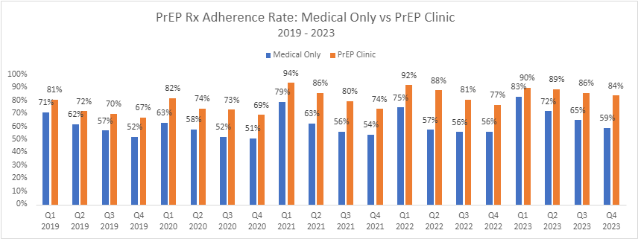
Peer PrEP Specialist Clinic: Higher Oral PrEP Care Retention vs. Medical Clinic (IAPAC 2023)
WWH Community Health Department
PrEP Clinic: Peer PrEP Specialist-led
Services: Medication, Lab Draw, Counseling, Scheduling, Follow Up Visits, Reminders, Referral for Acute/Primary/Mental Health Care
Total oral PrEP clients: > 3,475

Slide 4
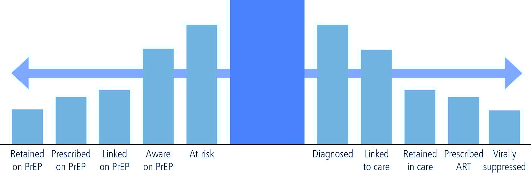
Status Neutral Continuum
WWH Implementing the Injectable Care Continuum
PrEP Care Continuum
HIV Care Continuum
WWH Peer PrEP Specialists
WWH Medical Assistants
HIV Test
Buchbinder SP and Liu AY. Top in Antivir Med 2018
Nunn AS, et al. Defining the HIV pre-exposure prophylaxis care continuum. AIDS 2017
Chan PA, et al. Retention in care outcomes for HIV pre-exposure prophylaxis implementation programmes among men who have sex with men in three US cities. JIAS 2016
Chan PA, et al. Long-term retention in pre-exposure prophylaxis care among men who have sex with men and transgender women in the United States. JIAS 2019.

Slide 5
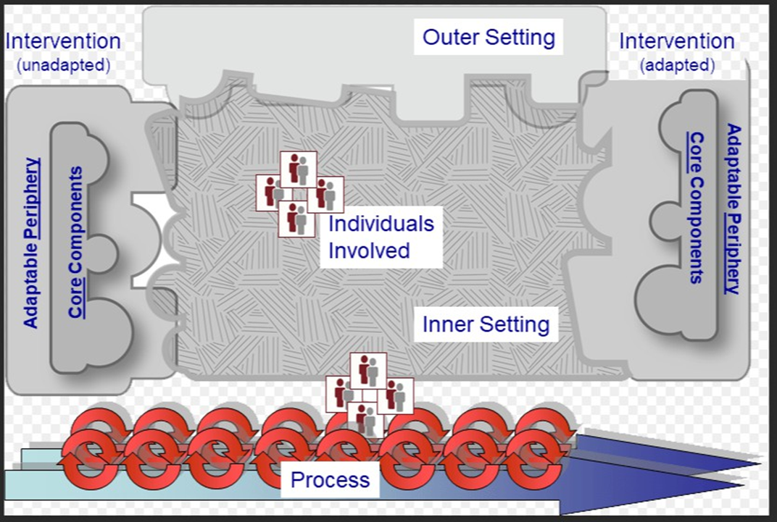
LAI CAB Implementation Process
Gather insights from other organizations
Review legal specifications
Identify staffing needs and hire new staff: full-time Injection Coordinator, 3 PrEP Injection Specialists, 2 PrEP Navigators, and Pharmacist LAI CAB Lead
Devise a clinical protocol and workflow
Appointment scheduling system
Missed appointment rescheduling within 1-7 days and follow up plan with Artera® texting and calls
LAI CAB pharmacy communication system
Medication acquisition and storage plan
Specialized electronic medical record changes and medical documentation format
Real-time dashboard to identify inventory, missed appointments and other information
Billing process with client billing communication
Demand generation plan
Examination room changes
Establish LAI CAB PrEP Specialist Training Program
Damschroder LJ, et al. 2009
Damschroder LJ, et al. 2022
Cfirguide.org

Slide 6
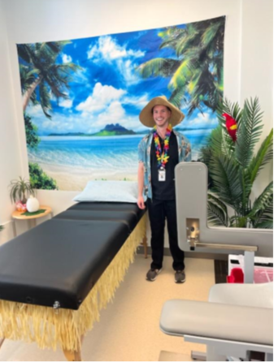
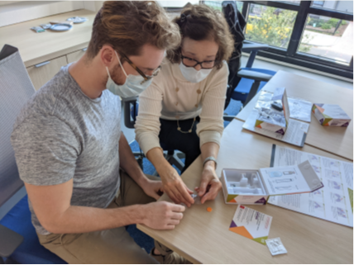
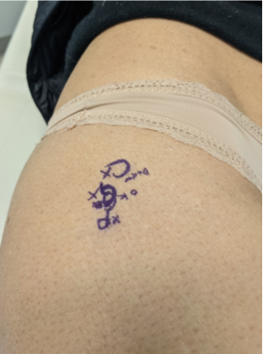
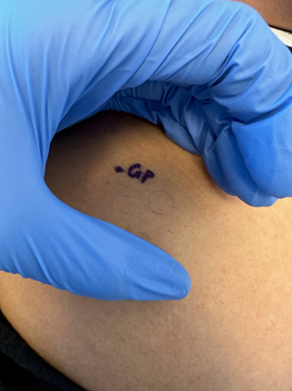
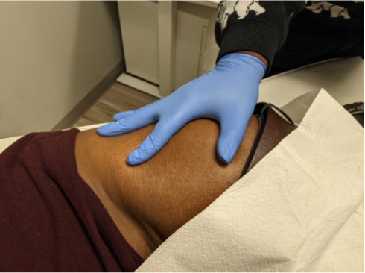
LAI CAB PrEP Injection Training Program
Didactic lectures
Separate sessions for injection preparation & landmark/injection site identification
Mock sessions
In-clinic observation by Specialists
Videotape review with feedback
Specialist observation by provider
Log of injections
Sessions: Group and 1-on-1
Surveys every month on comfort level and why
Checklist and exam
Weekly review of cases

Slide 7
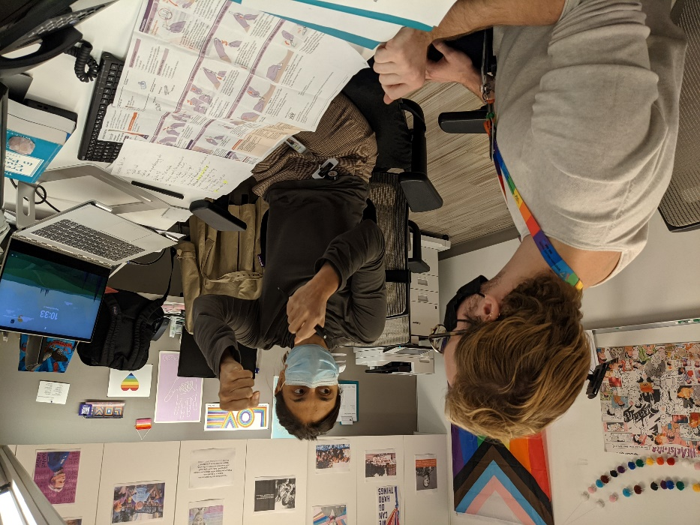
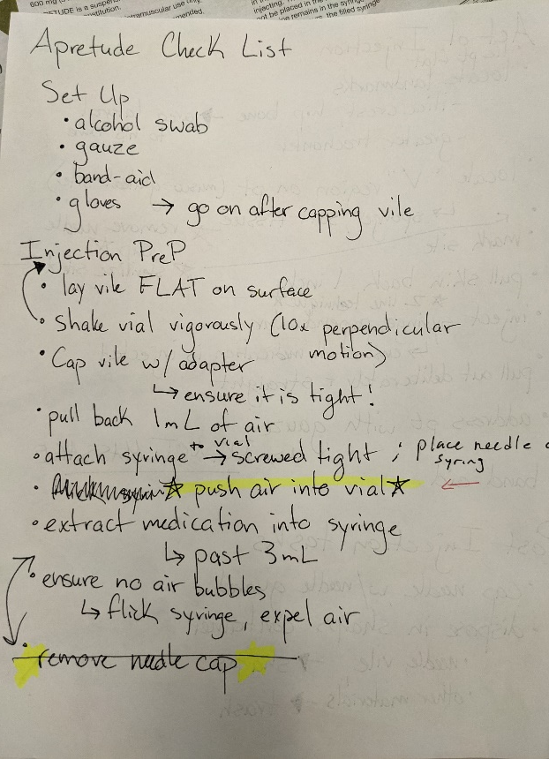
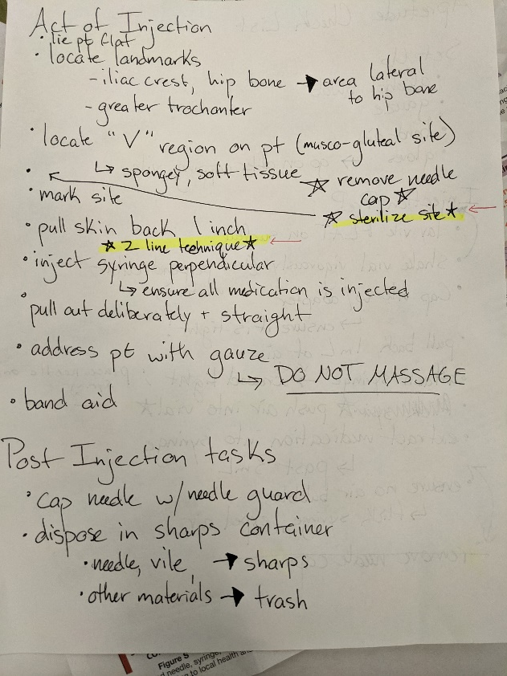
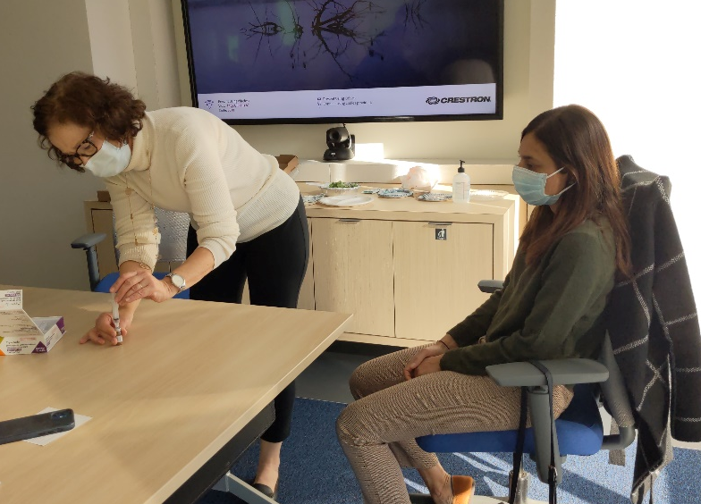
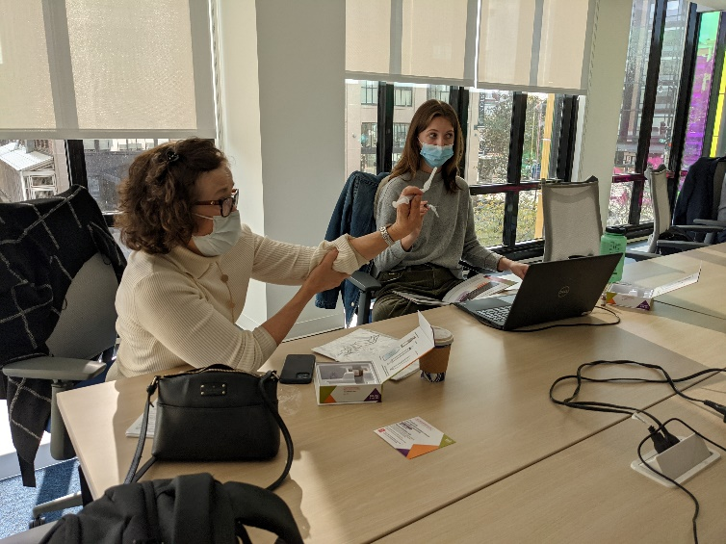
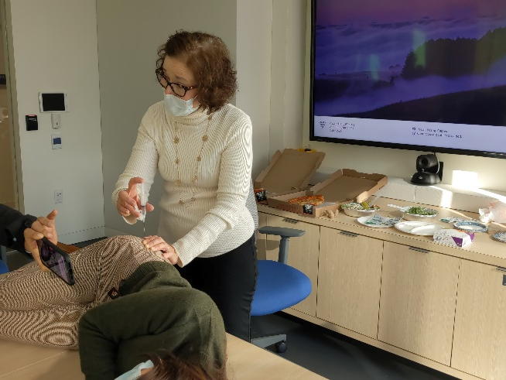
LAI CAB PrEP Injection Training Program

Slide 8
LAI CAB Patient Survey Results
 | Surveys results through 4/28
 | LAI CAB (n=23)
 | Great (Yes) | OK | Poor (No)
Experience Scheduling | 96% | 4% | 0%
Experience w/ Insurance | 90% | 5% | 5%
Experience w/ Injection | 91% | 9% | 0%
Schedule explained? | 100% | ------------- | 0%
Injectable PrEP (LAI CAB) is a new service for us. Please share any information that can help us to improve the patient experience:
“Easy experience with scheduling and staff”
“The actual injection was quite painful”
“No pain at all, easy to schedule”
“First dose was painful; second dose was much smoother”
“Wider range of appointment times to accommodate patients”
How would you describe Injectable PrEP (LAI CAB) to another patient who didn’t know what it was but wanted to learn?
“Be prepared to feel sore for more than a week"
“It's a way to be our protected from HIV without a daily regimen”
“It stays in your system for 2 months for HIV prevention”
Reasons for choosing Injectable PrEP (LAI CAB): | count | %
More convenient for my schedule than taking a pill | 15 | 38%
Easier to remember than taking a pill | 15 | 38%
Don’t like taking a pill | 7 | 18%
Some other reason | 2 | 5%
Total* | 39 | 100%
How did you hear about Injectable PrEP (LAI CAB)? | count | %
WWH medical professional (provider, other clinic staff) | 18 | 50%
External medical professional (external provider, clinic staff) | 1 | 3%
Another patient, friend, partner, or someone else | 5 | 14%
Saw information while in the clinic (poster, brochure) | 0 | 0%
Saw an ad on TV, social media, or somewhere else | 11 | 31%
Found out some other way | 1 | 3%
Total* | 36 | 100%
*Total higher than n due to selecting multiple response options

Slide 9
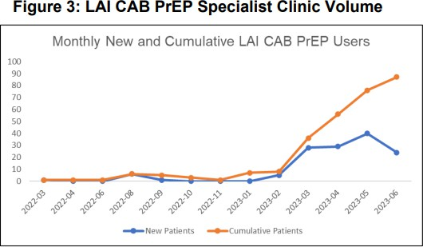
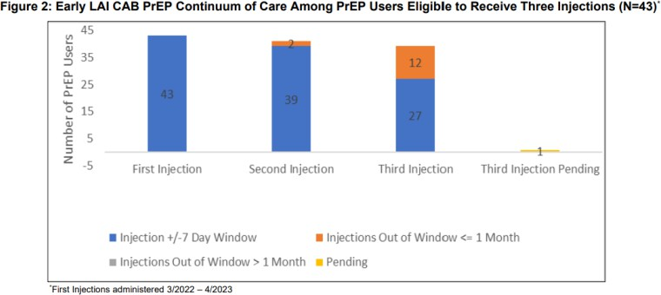
Feasibility and high early retention of CHW-administered CAB PrEP Program (IAS 2023)
WWH PrEP Services Pathway
CHW PrEP Clinic
Outreach Programs
Medical Primary Care
LAI CAB Program Start: March 2022
348 patients as of July 1, 2024

Slide 10
Moderate to High Retention among Black, Latinx, Transgender LAI CAB PrEP Users in a Peer Community Health Worker led Program within a Primary Care Center in Washington, D.C.
Juan Carlos Loubriel¹, Rupa Patel¹, Erin Kelley¹, Michael Golden¹, Rachel McLaughlin¹, Ramatoulaye Keita¹, Kevin Contreras¹, David Fessler¹, Megan Dieterich¹, Jun Tao ², Philip Chan², Meghan Davies¹
Whitman-Walker Health, Washington, D.C.
Brown University, Providence, RI
(IPAC 2024)

Slide 11
Program Description: 9-month LAI CAB PrEP retention
Data extracted from electronic health records (EHR) (eClinical Works®) and a related dashboard
(Relevant®); confirmed by medical chart review (prescriptions and appointments)
Location: Whitman-Walker Health’s peer PrEP Specialist clinic (Washington, D.C.)
9-month analysis: First injection received between March 2022 to June 2023
Population: LAI CAB PrEP users
Primary outcome: 9-month retention/adherence (received 6 consecutive injections)
Outcome defined as an injection received (+/-7 days) at 9 months (6th on-time injections)
Secondary outcomes: injection at 9 months (+/- 14 days), discontinuation rates (medical chart review) and reasons, number of seroconversions and false positive HIV test results
Transgender persons data extraction is based on self survey registration form in the EHR

Slide 12
Total LAI CAB PrEP Users WWH, March 2022 - March 2024
 | Total | White | Black/AA | Latinx | Transgender
PrEP Users Total | 314 | 157 | 97 | 61 | 47
Total Injections | 1324 | 649 | 436 | 252 | 197
Median Injections | 3 | 3 | 3 | 3 | 3
Injection Range | 1-12 | 1-12 | 1-11 | 1-7 | 1-11
Appts Scheduled | 1923 | 961 | 642 | 385 | 281
Switch from Oral PrEP | 293 (93%) | 146 (93%) | 90 (93%) | 59 (97%) | 43 (91%)
Total Discontinuations | 36 (11%) | 21 (13%) | 8 (8%) | 5 (14%) | 6 (13%)
No HIV seroconversions and one false positive HIV Ag/Ab test

Slide 13
9-Month Retention PrEP User Characteristics
 | Total | White | Black/AA | Latinx | Transgender
PrEP Users | 114 | 56 | 37 | 26 | 14
Median Age (Range) | 34 (21 - 62) | 36 (21 – 60) | 34 (24 – 56) | 35 (34 – 55) | 31 (21 – 44)
Male at Birth | 110 (97%) | 56 (100%) | 35 (95%) | 26 (100%) | 13 (93%)
Cisgender Women | 2 | 0 | 1 | 0 | 0
Gay/Bisexual | 96 (84%) | 51 (91%) | 29 (78%) | 21 (81%) | 4 (29%)
Transwomen | 14 (11%) | 6 (11%) | 4 (11%) | 6 (23%) | 14 (100%)
Public Insurance | 25 (22%) | 5 (9%) | 15 (41%) | 7 (27%) | 8 (57%)

Slide 14
WWH LAI CAB PrEP 9-Month Retention Outcomes
 | Total | White | Black/AA | Latinx | Transgender
PrEP Users | 114 | 56 | 37 | 26 | 14
Total Injections | 699 | 334 | 252 | 146 | 89
Median Injections | 4 | 4 | 4 | 3 | 4
Injection Range | 1-12 | 1-12 | 1-11 | 1-7 | 1-11
Appts Scheduled | 876 | 432 | 309 | 195 | 111
Switch from Oral PrEP | 108 (95%) | 52 (93%) | 36 (97%) | 25 (96%) | 14 (100%)
9-Month Retention +/- 7 Days | 78 (68%) | 38 (68%) | 26 (70%) | 14 (54%) | 9 (64%)
9-Month Retention +/- 14 Days | 92 (81%) | 45 (80%) | 33 (89%) | 18 (69%) | 11 (79%)
Most people attended their appointments within 7 days of the +/- 7 day on-time injection windows

Slide 15
LAI CAB PrEP 9-Month Retention Outcomes By Population
Most people attended their appointments within 7 days of the +/- 7 day on-time injection windows

Slide 16
LAI CAB PrEP 9-Month Retention Outcomes Over Time by Population
Steeper declines in retention for all populations by the third injection in this cohort

Slide 17
Discontinuations (and Why within 9 Months of LAI CAB PrEP Care)
 | Total | White | Black/AA | Latinx | Transgender
PrEP Users | 114 | 56 | 37 | 26 | 14
Discontinued (+/14 days retention) | 21/114 (18%) | 10 (18%) | 4 (11%) | 7 (27%) | 2 (14%)
Insurance-Related | 7/21 (33%) | 3 (30%) | 2 (50%) | 1 (14%) | 1 (50%)
Missed multiple appts/failed re-start/provider discontinued | 5 (24%) | 2 (20%) | 1 (25%) | 4 (57%) | 0
Sexual Relationship Changes - Monogamy | 1 (5%) | 0 | 1 (25%) | 0 | 0
Lost to follow up | 2 (10%) | 1 (10%) | 0 | 1 (14%) | 1 (50%)
Moved | 3 (14%) | 2 (20%) | 0 | 0 | 0
Inconvenient | 2 (10%) | 1 (10%) | 0 | 1 (14%) | 0
Injection Site Reaction | 1 (5%) | 1 (10%) | 0 | 0 | 0
All discontinuations were transitioned to 2-1-1 or daily oral PrEP except those who did not follow up nor had sexual relationship changes

Slide 18
Injectable PrEP CHW Program Lessons Learned
Moderate to high injectable PrEP retention was seen across vulnerable populations
May be a reflection of a selection bias (prior oral PrEP use and public insurance)
High rates of Medicaid use (~ 40 - 57%) may have eliminated barriers to access to care and may have fostered retention for injectable PrEP use among certain populations
Insurance-related issues caused injectable PrEP discontinuations among all populations
Missed appointments and lost to follow up remain reasons for non-retention

Slide 19
Conclusion and Program Recommendations
Peer CHWs can aid injectable PrEP retention/adherence among vulnerable communities to prevent new HIV infections
Robust solutions are needed to address lost to follow up and insurance-related discontinuations

Slide 20
Acknowledgements
PrEP Users
PrEP Specialists
PrEP Navigators
PHQ Team
Community Health Department Phlebotomists
Medical Department
RN team Billing Team Leadership

