Slide 1
Injectable PrEP Implementation at BCHD
Shanna Dell, MPH, RN, ACRN
PrEP and STI Clinic Nurse Manager
JHU PTC Protocol Specialist
Caroline Sacko, MSN, RN
Senior Clinical PrEP Nurse

Slide 2
PrEP at BCHD
Began offering PrEP in 2015 at the BCHD Sexual Health Clinics
Also have STI and HIV services
2 clinical sites in Baltimore City
Telehealth available
M-F, business hours
246 active patients as of 4/2022
Majority male (~88%)
Majority 25-34 (~45%)
Majority black (~62%)
RN-led clinic model
2 RNs
2 Peer Navigators
1 current, 1 open
1 Social Worker (hiring)
3 NPs
1 PA
1 Nurse Manager
1 HIV/PrEP Medical Director (NP)

Slide 3
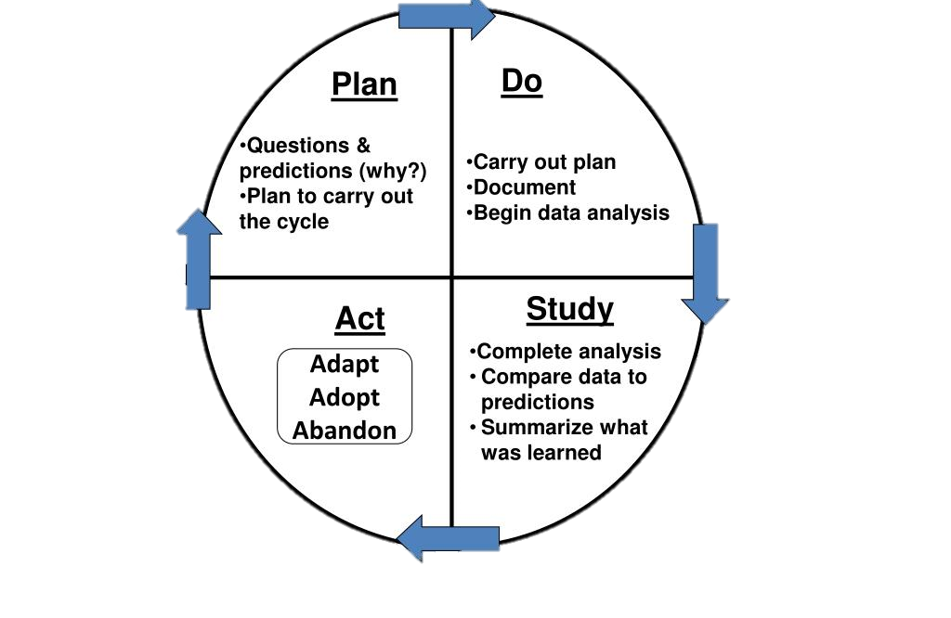
Process for Implementing Injectable PrEP
Pt. satisfaction survey had Q related to interest in injectable PrEP (HIGH)
PREP team meetings
PrEP RN taking lead
Planned for pilot
Created initial protocol
Pilot at one clinic
2/24/2022= 1st pt. visit
4/4/22= 1st injection given
Refine protocol
Don’t let “perfect” be the enemy of “good”
Pilot phase
Qualitative:
Ease of use
Experience at pt level and clinic level
Quantitative
#missed appts
# successful initiation w/ return

Slide 4
CAB-LA Patients
6 initial education completed
(1) 1st injection complete
(2) ongoing insurance negotiations - requiring letters of recommendation
(1) pending Viiv patient assistance program enrollment
(1) lost to follow up – medications already shipped
(1) decline to move forward

Slide 5
CAB-LA Initiation: Transition from Oral PrEP
Transition from Oral PrEP
Assess oral prep adherence
Non-adherent
Adherent
Obtain Rapid HIV test in clinic
Rapid HIV -
Obtain Baseline Labs
Rapid HIV +
CAB-LA Coverage obtained w/i 7 days
CAB-LA Coverage obtained after 7 days
No CAB-LA coverage obtained
Refer to HIV Program
Schedule a repeat RNA test as needed (in clinic or at Labcorp)
Maintain on Oral PrEP
Schedule initial injection visit w/i 7 days of baseline labs
Schedule initial injection

Slide 6
CAB-LA Initiation: PrEP Naive
PrEP Naïve
Baseline labs + Rapid
Rapid HIV +
Rapid HIV -
Refer to HIV Program
Offer oral PrEP if no contraindications
CAB-LA Coverage obtained w/i 7 days
CAB-LA Coverage obtained after 7 days
No CAB-LA coverage obtained
Baseline labs:
-HIV RNA
- Hep C
- Hep B serology
- CMP
-Lipid panel
- RPR
-CT/GC NAAT
Schedule initial injection visit w/i 7 days of baseline labs
Schedule a repeat RNA test as needed (in clinic or at Labcorp)
Maintain on Oral PrEP
Schedule initial injection

Slide 7
CAB-LA Visit Schedule
Initiation
Month 1
Month 2
Month 4
(q4 months)
Baseline Labs
HIV RNA test and assess for acute infection
HIV RNA test and assess for acute infection
HIV RNA test and assess for acute infection
Patient education, risk assessment and adherence counseling
1st injection
Respond to initial questions
STI Screening
Obtain coverage
2nd injection
Adherence counseling and risk assessment
3rd injection
Month 6
Month 8
(q4 months)
Month 10
Month 12
(q4 months)
HIV RNA test and assess for acute infection
HIV RNA test and assess for acute infection
HIV RNA test and assess for acute infection
HIV RNA test and assess for acute infection
Adherence counseling and risk assessment
STI Screening
Adherence counseling and risk assessment
STI screening
4th injection
Adherence counseling and risk assessment
6th injection
Adherence counseling and risk assessment
5th injection
Assess desire to continue prep injections

Slide 8
Patient Education – 7 main points
Medication indication
Discuss risk factors and signs and symptoms of acute HIV infection
Continuing oral PrEP or, starting 28-day oral cabotegravir lead-in until 1st injection
Dosing and testing schedule
Manage expectations about time to 1st injection
Counsel on adherence and time to protection
Review common side effects
Injection site reaction, N/V/D, HA, fever, fatigue
Review adverse effects
Allergic reaction, liver impairment, depression
Pregnancy and CAB
Discontinuing CAB-LA
Long tail and quarterly HIV RNA tests (make a contract to commit?)

Slide 9
Patient Pipeline Considerations
Insurance vs uninsured
Viiv Connect for benefits investigation
Patient authorization esign-ondemand (viivconnectportal.com)
Deductibles – Apretude Savings Program ($7,500 annually)
Viiv Online Portal – glitchy, advised against using this
Time to medication delivery from benefits investigation: 10-14 days
Delays: Letter of Medical Necessity
HIV RNA results review
Scheduling/Delivery
How to organize deliveries?
Rx Injection #2 right after injection #1 visit
Rx for bi-monthly injections 2-4 weeks prior to admin, refills ready
How to schedule?
Schedule patients at beginning of 14-day window
Cluster injectable clinic visits?

Slide 10
Contact Info
Caroline Sacko
Caroline.sacko@baltimorecity.gov
Shanna Dell
Shanna.dell@baltimorecity.gov OR sdell2@jhu.edu

