Slide 1
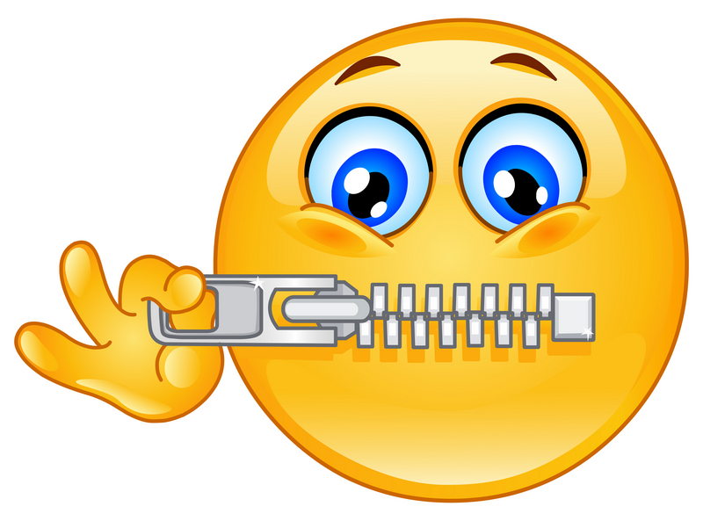
WHAT YOU SAY IN HERE,
STAYS IN HERE
UNLESS:
SOMEONE IS HURTING YOU
YOU WANT TO HURT SOMEONE
YOU WANT TO HURT YOURSELF

